Slide 1
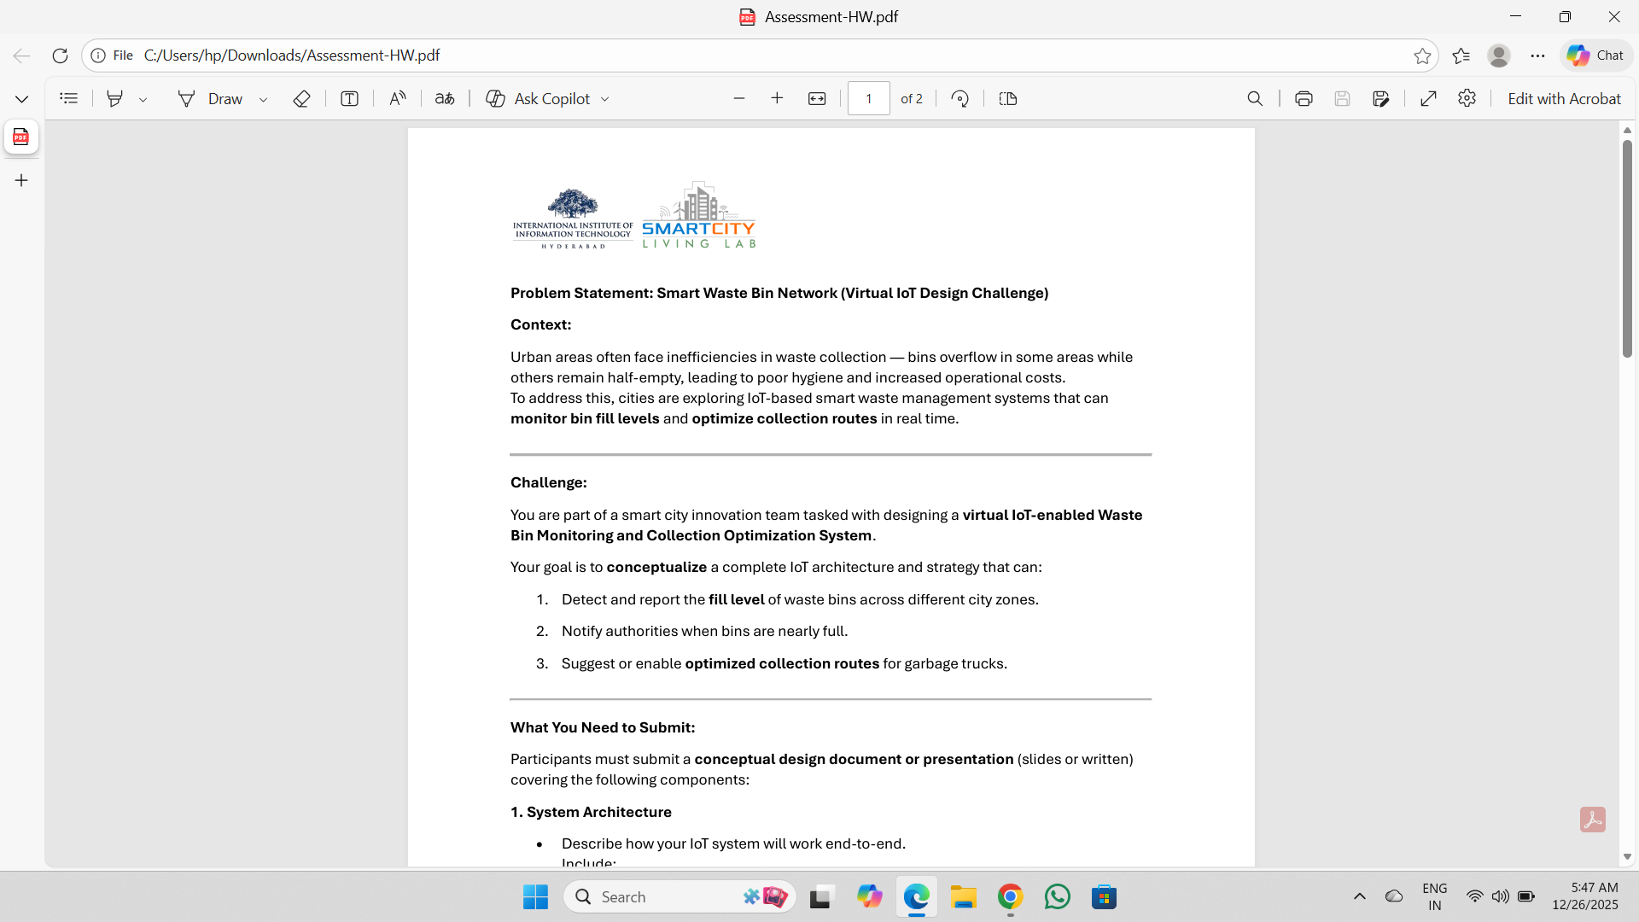
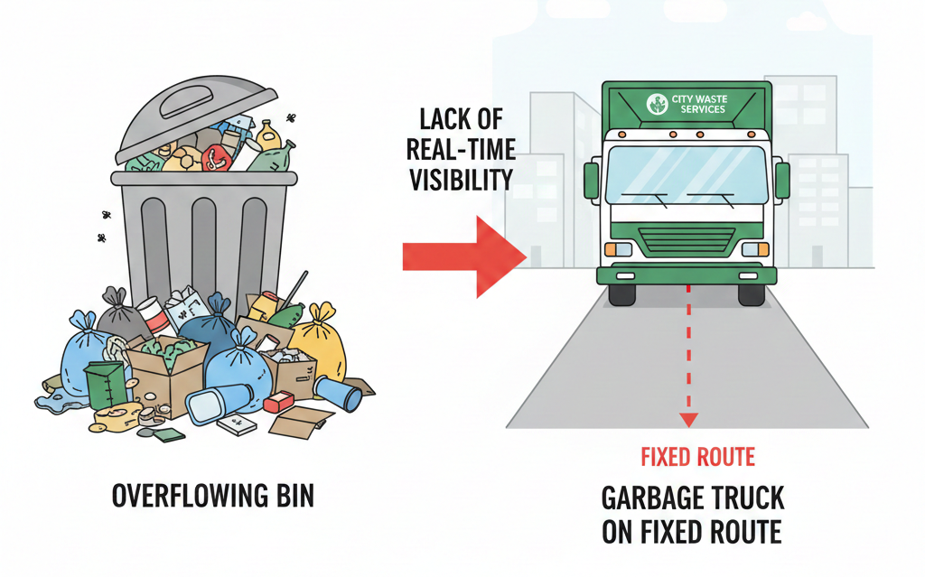
Smart Waste Bin Monitoring and Collection Optimization System
Name: S DILEEP KUMAR
College: ALLLIANCE UNIVERSITY
Problem Statement:
Urban waste collection is largely static and schedule-based, leading to overflow in some areas and underutilized collection in others.
Lack of real-time visibility into bin fill levels causes poor hygiene and increased operational cost.
There is a need for a scalable, low-power, data-driven waste monitoring system.

Slide 2
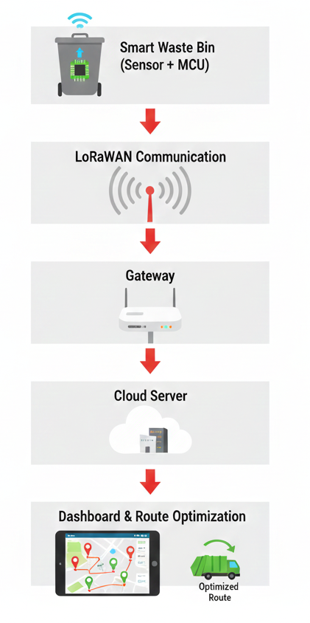
Overall System Architecture
Each waste bin is equipped with an ultrasonic sensor and a low-power microcontroller to measure the bin fill level locally.
The processed fill status is transmitted using LoRaWAN to a nearby gateway and forwarded to the cloud server.
The cloud platform stores data, generates alerts, visualizes bin status on a dashboard, and suggests optimized collection routes.

Slide 3
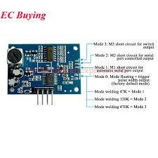
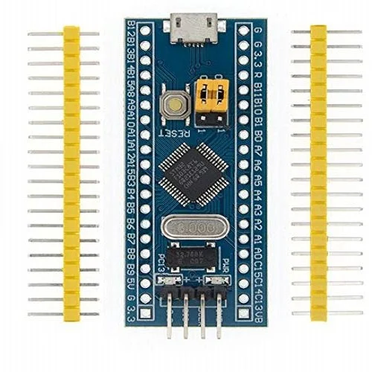
Sensor & Microcontroller Selection
Ultrasonic Sensor
STM32L
Working Principle:
Measures the distance between the sensor (mounted on the bin lid) and the waste surface to estimate fill level.
Why Ultrasonic Sensor?
Non-contact and hygienic
Low power consumption
Cost-effective for large-scale deployment
Suitable for irregular waste shapes
Working Principle:
Low-power microcontroller
Performs local processing (edge computing) at the bin
Why STM32L?
Supports deep sleep modes for battery operation
Sufficient processing for filtering and threshold logic
Compatible with LoRa communication modules

Slide 4
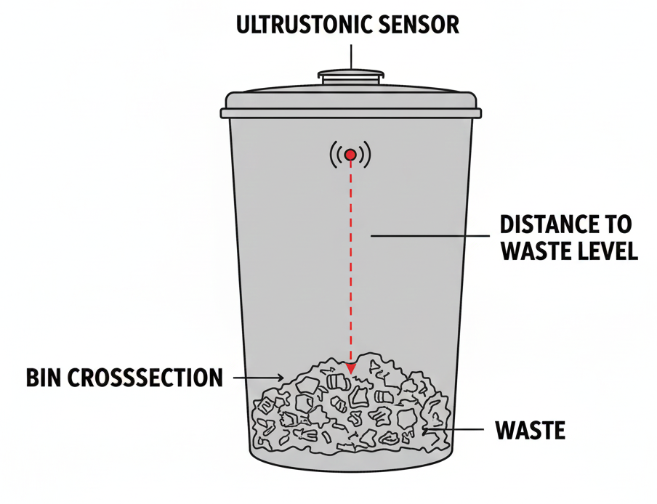
Sensor Placement & Fill Detection Method
Sensor Placement
Ultrasonic sensor is mounted centrally on the inner side of the bin lid.
Sensor is oriented vertically downward toward the waste surface
Why This Placement?
Ensures direct vertical distance measurement
Minimizes side-wall and angular reflections
Provides consistent and repeatable readings
Fill Detection Method
When the bin is empty, the measured distance is maximum
As waste accumulates, the measured distance decreases
The fill level is estimated based on the change in distance

Slide 5
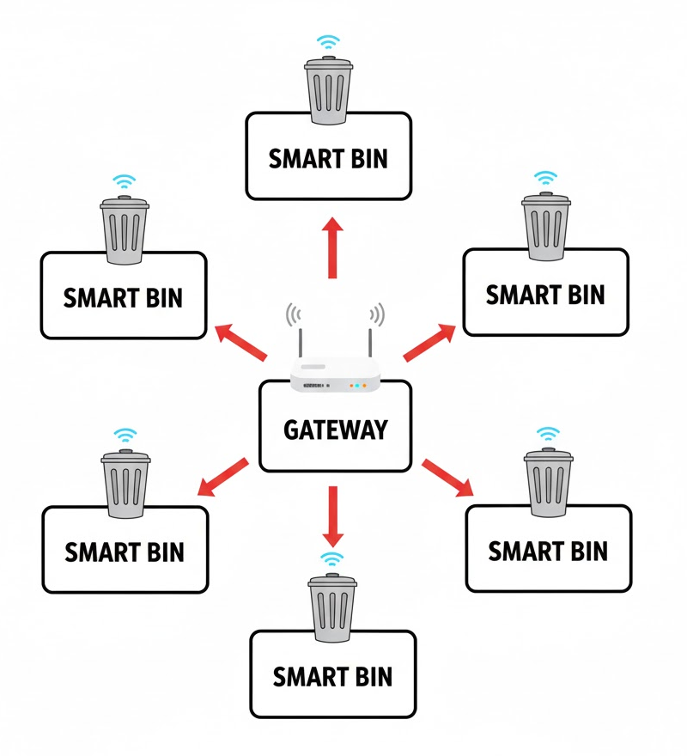
Data Communication Method
LoRaWAN
Long-range communication suitable for city-wide deployment.
Ultra-low power consumption, ideal for battery-operated bins
Star topology, simplifying network management.
No SIM or recurring subscription cost
Designed for small, infrequent data packets
Why Not Wi-Fi or Cellular?
Wi-Fi:
High power consumption
Limited outdoor coverage
Cellular (NB-IoT):
Requires SIM and recurring cost
Higher operational expense at scale
Network Topology
Star topology:
Bin nodes communicate directly with the gateway
Improves reliability and scalability

Slide 6
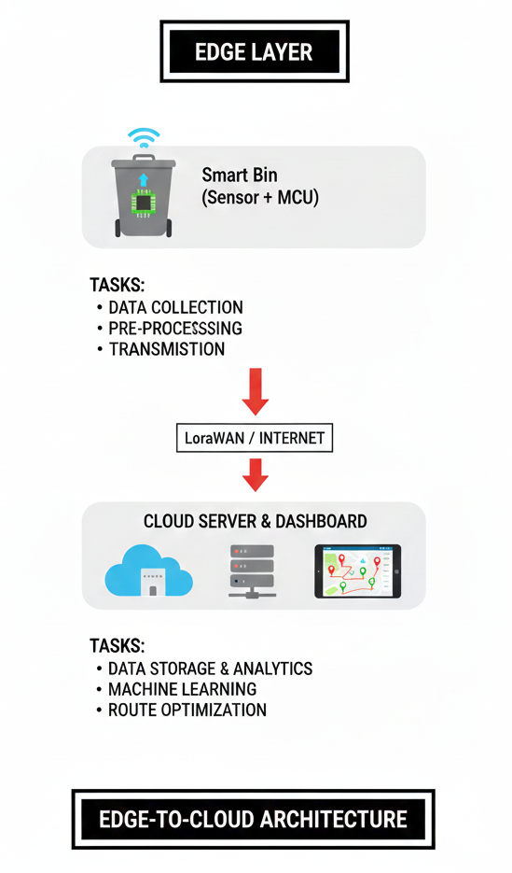
Edge vs Cloud Computing Strategy
Edge Computing (At the Bin Node)
Ultrasonic sensor data acquisition
Noise filtering and validation
Fill percentage calculation
Threshold evaluation (Green / Yellow / Red)
Transmission of only relevant data
Why Edge Computing?
Reduces data transmission frequency
Lowers power consumption
Improves system responsiveness
Cloud Computing (Central Platform)
Long-term data storage
Dashboard visualization for authorities
Alert generation and reporting
Route optimization and analytics

Slide 7
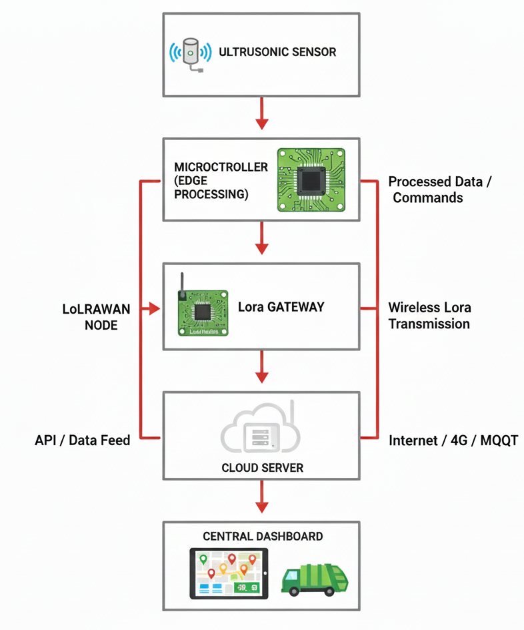
Data Flow Design
Ultrasonic sensor measures the distance to the waste surface.
Microcontroller filters readings and computes fill percentage.
Processed data is transmitted periodically via LoRaWAN.
Gateway forwards data to the cloud using the internet backhaul.
Cloud stores data and updates the dashboard in real time.
Data Characteristics
Small payload size (few bytes)
Low transmission frequency
Event-based alerts for critical fill levels

Slide 8
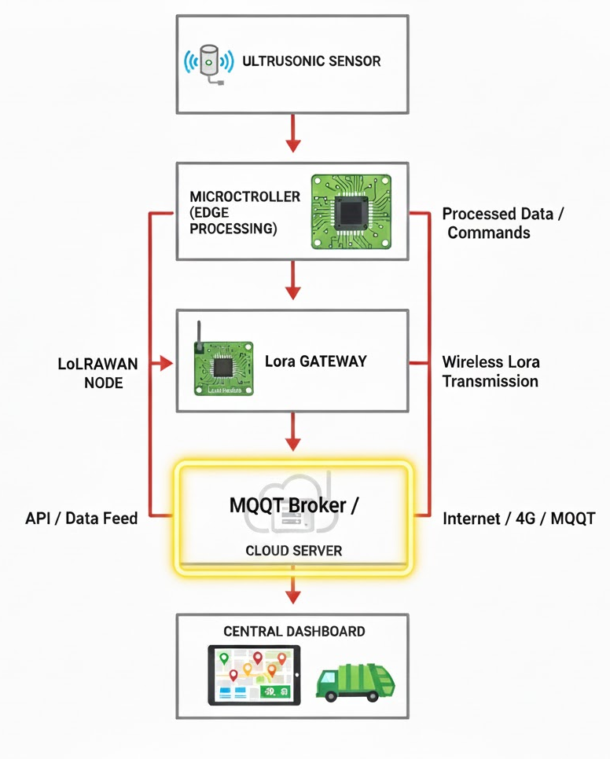
Communication Protocols
MQTT (Message Queuing Telemetry Transport)
Lightweight and low-power → ideal for IoT nodes
Publish–Subscribe model → decouples sensors from dashboard
Topic structure example:
city/zone/binID/status
Ex: bangalore/zone3/bin045/status
Why not HTTP:
HTTP → heavier, request-response model
Higher energy consumption
Less efficient for frequent small messages

Slide 9
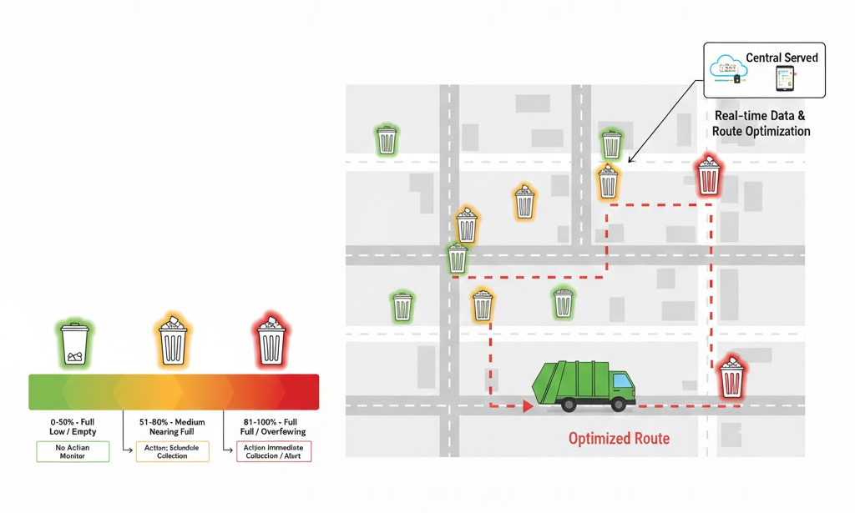
Fill Level Threshold Strategy
Green (<60%) → No action needed
Yellow (60–80%) → Plan collection soon
Red (>80%) → Immediate collection required
Purpose: Prevent overflow and optimize collection routes
Calibration Strategy
Each bin is calibrated once when empty
The empty-bin distance is stored as a reference
This compensates for different bin sizes and shapes

Slide 10
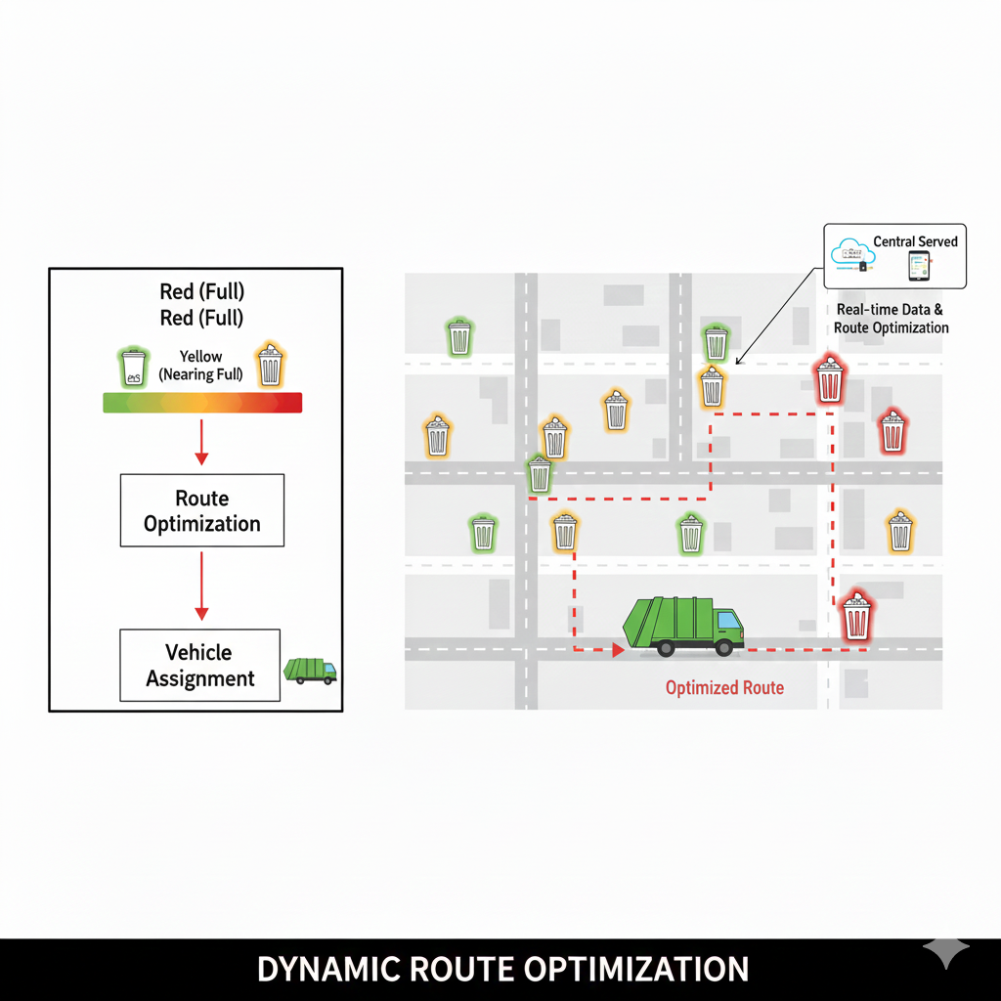
Route Optimization Strategy
Priority-based routing:
Red bins first → critical collection
Nearby yellow bins added → improve efficiency
Algorithmic approach:
Modified Dijkstra / A shortest path* for local routing
Greedy Heuristic / Nearest Neighbor for VRP (Vehicle Routing Problem)
Can be extended with Genetic Algorithm (GA) for large-scale route optimization
Flowchart of decision process:
Identify Red bins
Add Yellow bins in proximity
Optimize route using chosen algorithm → assign vehicle

Slide 11
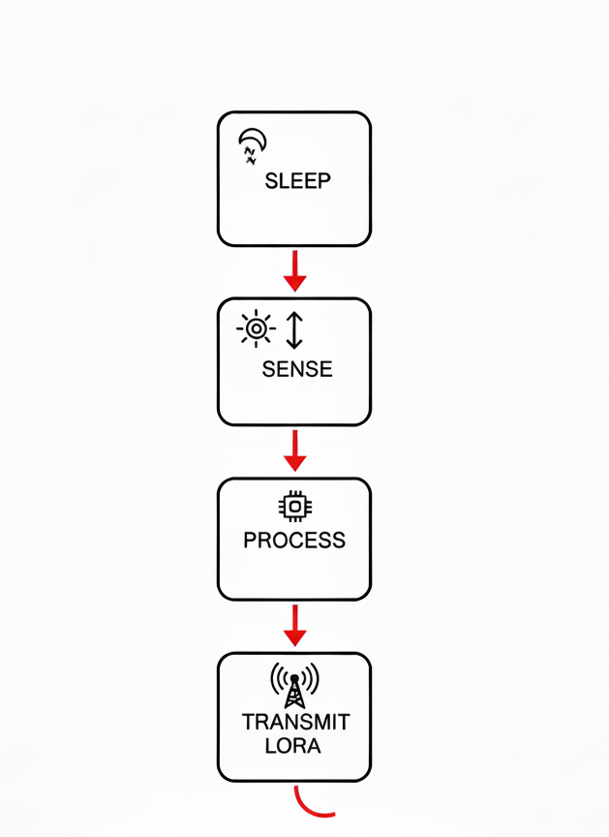
Power Management Plan
Deep Sleep Mode
Microcontroller remains in deep sleep most of the time
Wakes up only for sensing or transmission
2. Periodic Sensing
Ultrasonic sensing performed every 30 minutes
Avoids continuous sensor operation
Balances responsiveness and power usage
3. Event-Based Transmission
Data transmitted only when needed:
Threshold crossing (60%, 80%)
Significant change in fill level
Periodic heartbeat sent at long intervals
Expected Battery Life
Optimized sensing and communication
Estimated operational lifetime: 5–10 years per bin

Slide 12
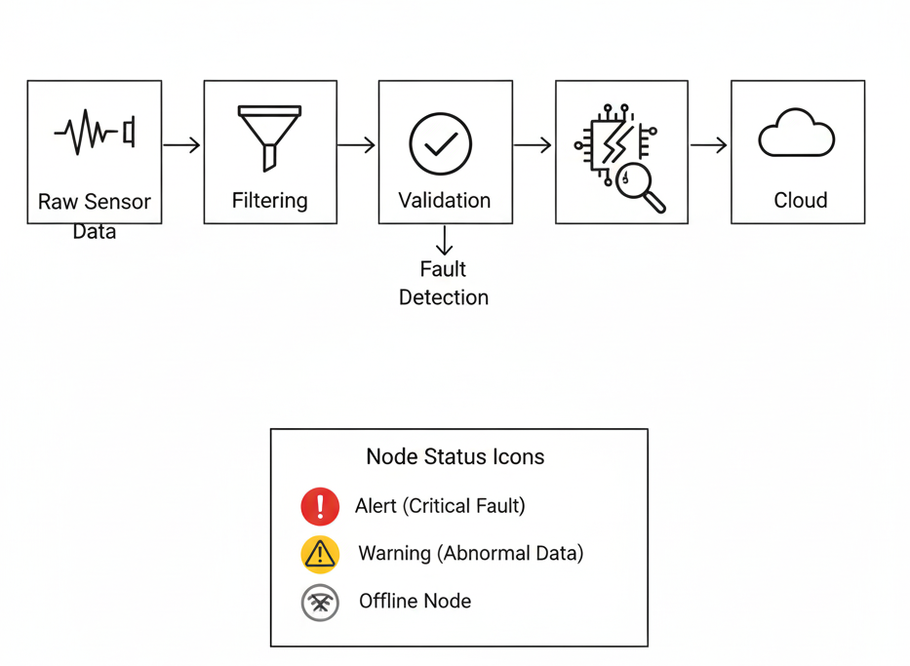
Reliability & Fault Handling
Handling False Sensor Readings
Multiple ultrasonic readings are taken per measurement cycle
Median filtering is applied to remove outliers
Confidence Scoring
Each fill-level estimate is assigned a confidence score
Low-confidence readings are:
Ignored temporarily
Revalidated in the next sensing cycle
Offline Node Detection
Each bin sends a periodic heartbeat message
If no message is received within a defined time window:
Node is marked as offline
Maintenance alert is generated
Stuck Sensor Detection
Detects abnormal behavior such as:
No change in fill level over long duration
System flags the bin for inspection and reduces alert priority

Slide 13
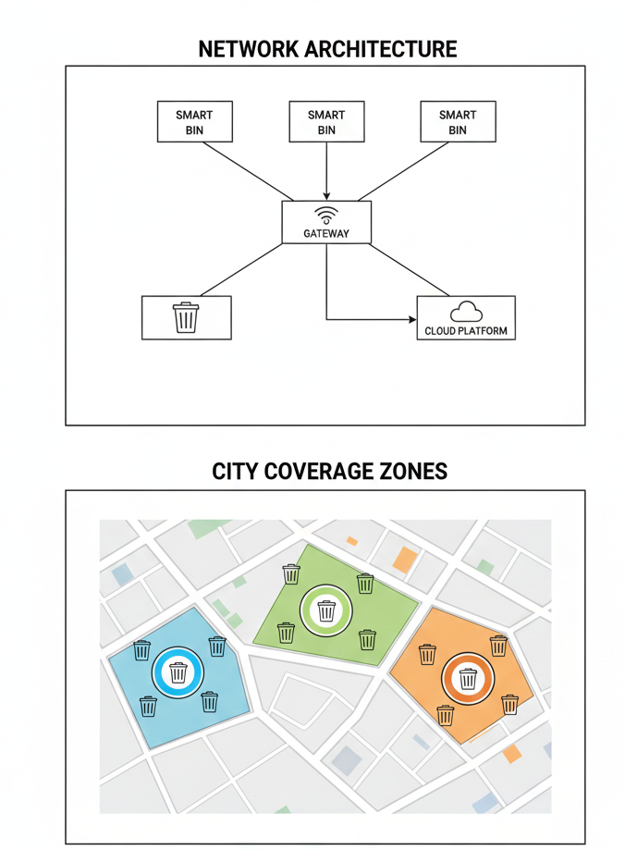
Scalability & Network Considerations
Network topology:
Star topology (LoRaWAN)
End nodes communicate directly with gateway
Scalability:
Supports 100+ bins per gateway
Easy addition of new bins without network redesign
3. Zone-based deployment:
City divided into zones, each with one or more gateways
Improves coverage and load distribution
Why not mesh topology:
Higher power consumption
Increased routing complexity
Not suitable for low-power, long-range nodes

Slide 14
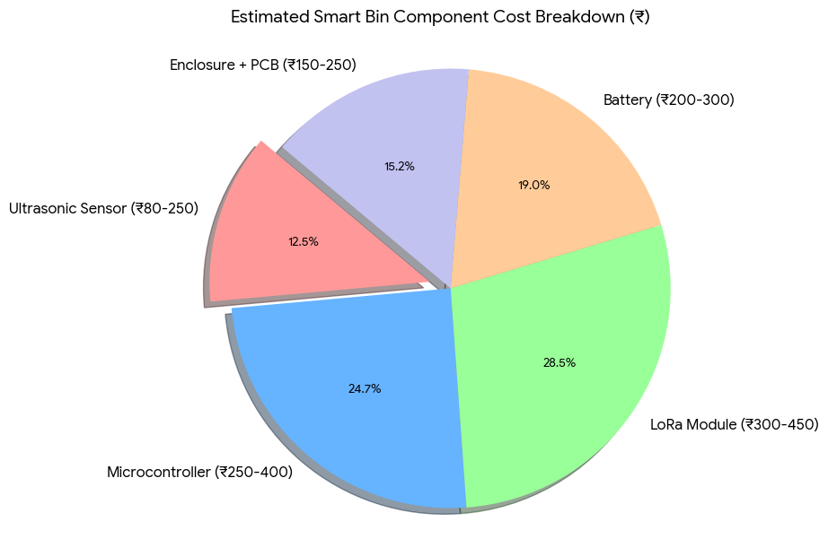
Cost & Feasibility
Component | Example Part | Cost (₹)
Ultrasonic Sensor | JSN-SR04T | 80 – 250
Microcontroller | STM32L series | 250 – 400
LoRa Module | SX1278 (Ra-02) | 300 – 450
Battery | Li-ion (3.6V) | 200 – 300
Enclosure + PCB | Weather-proof | 150 – 250
Total Cost per Bin: ₹1500 – ₹2000
Feasibility Points:
No SIM or recurring data cost (LoRaWAN)
Multi-year battery operation → low maintenance
Economically scalable for municipal deployment

Slide 15
Conclusion & Future Work
Conclusion:
Proposed a low-power, LoRaWAN-based smart waste monitoring system
Edge processing reduces communication overhead and power consumption
Priority-based routing improves collection efficiency and prevents overflow
System is scalable, cost-effective, and suitable for city-scale deployment
Future Work:
Hybrid sensing: Combine ultrasonic with weight or IR sensors for higher accuracy
Predictive analytics: ML-based fill-level prediction using historical data
Dynamic routing: Real-time traffic-aware route optimization
System integration: Link with municipal ERP and smart city platforms

